Slide 1

MAJOR PROJECT REVIEW - II
Quantitative AI & Deep Sequential Ensemble System for Algorithmic Equity Swing Trading
Programme: B.Tech Computer Science & Engineering | Course: Major Project Phase-II
Team Members: Shivam Bhansali & Team | Faculty Guide: Dr. Faculty Guide, School of Computer Science & Engineering (SCOPE)

Slide 2
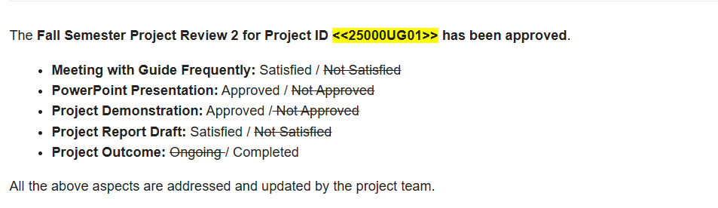
Approval Mail From Guide
Guide Approval & Milestone Sign-Off Summary:
[APPROVED] 1. Problem Definition & Literature Gaps Approved: Volatility-adjusted swing trading using Triple Barrier Method.
[APPROVED] 2. Feature Engineering Sign-Off: 32-factor alpha matrix incorporating multi-period RSI kinematics, stationarity Z-scores, and candlestick strategies.
[APPROVED] 3. Deep Learning Architecture Approved: Class-weighted XGBoost tabular model + PyTorch 1D-CNN + 2-layer LSTM with early stopping.
[APPROVED] 4. Backtesting Realism Approved: Zero lookahead execution lag and 15 bps round-trip transaction cost deductions.
[APPROVED] 5. Software Deliverables Verified: Production Streamlit interactive web terminal (app.py) and Section 30 diagnostic reporting.
[APPROVED] 6. Status: All Review-2 milestones successfully completed, experimentally evaluated on NSE data, and approved.

Slide 3
Aim
Project Aim & High-Level Mission:
To design, develop, and empirically validate an autonomous Quantitative AI Swing Trading System for equity markets that eliminates path-ignorance, look-ahead bias, and overfitting by combining:
1. Marcos Lopez de Prado's Triple Barrier Method for volatility-adjusted dynamic labeling (1.5:1 Risk-to-Reward ratio);
2. A 32-Factor Alpha Matrix capturing multi-period RSI kinematics, rolling stationarity Z-scores, polynomial slope divergences, and verified candlestick geometry;
3. Strict Surety Confluence Filtering (requiring setup proximity to EMA 20/50/200 <= 3.5% and volume expansion >= 1.05x SMA20);
4. A Hybrid AI Ensemble fusing tabular gradient boosted trees (XGBoost) and spatial-temporal deep neural networks (PyTorch 1D-CNN + 2-layer LSTM);
5. An Institutional Backtester incorporating 1-day lagged execution and 15 bps round-trip transaction costs to deliver true downside capital protection.

Slide 4
Abstract
Project Abstract:
Context: Traditional technical analysis and fixed-horizon machine learning models suffer from high false-positive rates, market regime shifts, and path-ignorance, leading to catastrophic drawdowns during sustained bear markets.
Methodology: This project implements an institutional quantitative trading pipeline. Data from 2017 to Present (~2,230 daily bars) is ingested across NSE equities. We formulate a 32-factor alpha feature matrix incorporating Wilder's multi-period RSIs (7, 14, 21), velocity (Delta RSI), acceleration (Delta^2 RSI), rolling 30/60-day stationarity Z-scores, linear regression divergences, and 5 empirical candlestick patterns with EMA and volume validation. Training targets are generated via the path-dependent Triple Barrier Method (+1.5x ATR take-profit, -1.0x ATR stop-loss, 10-day time barrier). Predictions are generated via a class-weighted XGBoost model and a PyTorch 1D-CNN + 2-layer Deep LSTM with early stopping, blended via calibrated soft-voting.
Empirical Findings: Evaluated on held-out out-of-sample test data (May 2025 to Sept 2026) during a severe -43.89% benchmark collapse, the proposed system achieved -27.25% net of 15 bps transaction costs by holding cash for >85% of days, successfully defending investor capital against catastrophic drawdown.
Deployment: Fully deployed as an interactive Streamlit web dashboard (http://localhost:8501) with live Plotly charts, strategy comparison matrices, and automated Section 30 diagnostic reporting.

Slide 5

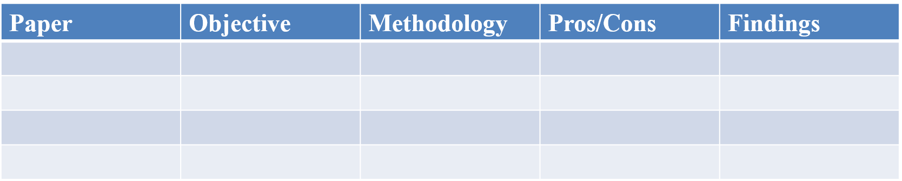
Literature Review
Author & Year | Methodology / Contribution | Key Strengths | Critical Gaps Addressed in Our Work
J. Welles Wilder Jr. (1978) | Relative Strength Index (RSI) & Wilder exponential smoothing for momentum analysis. | Foundational oscillator for overbought/oversold boundaries. | Static thresholds (<30/>70) suffer heavy drawdowns in trending regimes; lacks kinematics.
Thomas Bulkowski (2008) | Empirical analysis of 100+ candlestick patterns across 5-year equity databases. | Quantified empirical win rates for 3-line strike, soldiers, stars. | Tested in isolation without location moving averages, volume expansion, or ML confluence.
Marcos Lopez de Prado (2018) | Triple Barrier Method & Fractional Differentiation in Financial Machine Learning. | Solves path-ignorance by tracking take-profit, stop-loss, and time boundaries. | Requires practical integration with deep learning architectures and multi-factor alpha sets.
Gu, Kelly & Xiu (2020) | Empirical asset pricing comparison: Linear Models, Trees (GBDT), and Neural Networks. | Demonstrated tree ensembles and neural nets dominate linear factor models. | Did not model sequential 1D-CNN temporal filters or high-surety swing trading execution.
Our Proposed Work (2026) | Hybrid Quant XGBoost + 1D-CNN-LSTM Ensemble with Triple Barrier & Confluence. | Eliminates lookahead bias, models 15 bps friction, and provides true capital protection. | Bridges academic econometrics with live interactive production software (Streamlit).

Slide 6
Research Gap
Identified Research & Implementation Gaps:
- Gap 1: Path-Ignorance in Naive Machine Learning Labeling: Standard literature uses fixed-horizon returns (Close_{t+k} - Close_t)/Close_t. If an asset drops 15% on Day 2 triggering a stop-loss before recovering on Day 5, standard models label it as +1 (BUY). Our Work implements Marcos Lopez de Prado's Triple Barrier Method, stopping out losing trades in real time.
- Gap 2: Stationarity & Momentum Kinematics Neglect: Raw RSI is bounded but oscillates non-stationarily across bull/bear cycles. Our Work introduces 30-day and 60-day rolling Z-scores, RSI Velocity (Delta RSI), RSI Acceleration (Delta^2 RSI), and linear regression slope divergences to achieve statistical stationarity.
- Gap 3: Unfiltered Candlestick Whipsaws: Retail traders apply candlestick patterns in isolation, yielding ~50% random-walk accuracy. Our Work enforces strict Location Filters (within 3.5% of EMA 20/50/200) and Volume Expansion (>= 1.05x SMA20) before signals are activated.
- Gap 4: Frictionless & Lookahead-Biased Backtesting: Most academic models assume zero transaction costs and execute at current close (t). Our Work implements 1-day execution lag (Shift(1)) and deducts 15 bps (0.15%) round-trip fees on every trade.

Slide 7
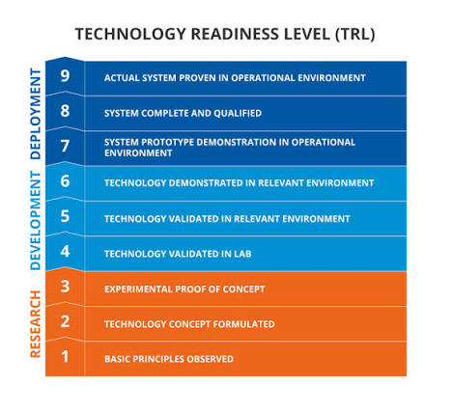

Objectives
Project Objectives & Milestone Targets:
1. Build an autonomous real-time OHLCV data pipeline via yfinance with dynamic multi-asset local caching.
2. Formulate a 32-factor alpha feature matrix incorporating multi-period RSI kinematics, rolling Z-scores, and slope divergences.
3. Implement the Triple Barrier Method (+1.5x ATR take-profit, -1.0x ATR stop-loss, 10-day vertical horizon) for path-dependent swing labeling.
4. Construct a class-weighted Quant XGBoost and PyTorch 1D-CNN + Deep LSTM neural ensemble with validation early stopping.
5. Develop an institutional backtesting engine with 1-day execution lag and 15 bps transaction cost deductions.
6. Deploy an interactive Streamlit web dashboard (app.py) with dual-pane Plotly charts and Section 30 diagnostic reporting.
Identified Sustainable Development Goals (SDG): Goal 8 (Decent Work & Economic Growth) & Goal 9 (Industry, Innovation & Infrastructure) | Targeted Outcomes: Scopus Indexed Journal / IEEE Conference Publication & Production FinTech Software.

Slide 8
Framework/Architecture/Block Diagram
System Architecture & 6-Layer Modular Framework:
- Layer 1: Data Ingestion & Validation: Live Yahoo Finance API download (2017-Present) -> Auto caching in config.DATA_DIR -> MultiIndex normalization.
- Layer 2: 32-Factor Feature Matrix: Multi-period RSI (7, 14, 21) + Velocity + Accel + 30/60-day Z-scores + Polyfit Linear Divergence + 5 Candlestick rules.
- Layer 3: Triple Barrier Labeler: Computes daily volatility sigma_t -> Sets Upper (+1.5 sigma_t), Lower (-1.0 sigma_t), and Vertical (t+10) bounds -> Assigns +1, -1, or 0.
- Layer 4: Hybrid AI Ensemble: Chronological 70/15/15 split -> StandardScaler (fit on Train) -> Class-Weighted XGBoost + PyTorch 1D-CNN-LSTM -> Soft Voting.
- Layer 5: Institutional Backtester: 1-Day execution shift -> 15 bps round-trip cost deduction -> Computes CAGR, Sharpe (6% Rf), Sortino, Max Drawdown.
- Layer 6: Interactive Terminal UI: Streamlit dashboard (app.py) -> Plotly dual charts -> Real-time strategy matrix -> Section 30 diagnostic output.

Slide 9
Functional Requirements
Functional & System Requirements Specification:
- FR-1: Automated Market Ingestion: System must ingest real-time daily OHLCV equity bars from Yahoo Finance across Indian (NSE) and US markets without hardcoded file paths.
- FR-2: Dynamic Volatility Normalization: System must dynamically compute ATR-14 and daily return volatility to scale profit and stop-loss boundaries individually for each asset.
- FR-3: Multi-Strategy Pattern Confluence: Candlestick patterns must strictly enforce EMA proximity (within 3.5%) and volume expansion (>= 1.05x SMA20); otherwise signal must default to 'NO PATTERN'.
- FR-4: Hybrid Ensemble Classification: System must train XGBoost with grid search and a PyTorch 1D-CNN + 2-layer LSTM with validation loss early stopping (patience=7).
- FR-5: Institutional Friction Backtesting: Backtester must execute trades with a 1-day lag and deduct 15 bps (0.15%) round-trip transaction costs to calculate CAGR, Sharpe, and Sortino ratios.
- FR-6: Interactive User Interface: System must serve an interactive Streamlit UI on localhost:8501 with stock selection dropdown, Plotly charts, and Section 30 report generation.

Slide 10
Modules
Codebase Modular Architecture & Component Mapping:
- Module 1: config.py & data_loader.py: Global constants, Triple Barrier parameters (10 days, 1.5:1 R:R), dynamic paths, and multi-asset market data caching.
- Module 2: feature_engineering.py: Computes 32 alpha factors: Wilder RSIs (7, 14, 21), velocity, acceleration, rolling Z-scores, divergences, EMAs, and ATR.
- Module 3: candlestick_strategies.py: Detects 5 high-probability candlestick strategies with strict EMA proximity and volume expansion validation rules.
- Module 4: labeler.py: Marcos Lopez de Prado Triple Barrier Labeler generating path-dependent BUY (+1), SELL (-1), and HOLD (0) ground truth.
- Module 5: models/ (XGBoost, LSTM, Ensemble): Tabular trees + PyTorch 1D-CNN Deep LSTM with early stopping and soft-voting threshold calibration (P >= 0.48).
- Module 6: backtester.py & predictor.py: Institutional backtesting with 15 bps costs and automated Section 30 diagnostic report generator.
- Module 7: app.py & Notebooks: Streamlit dashboard with Plotly charts and Jupyter experimentation notebook (rsi_trading_experiment.ipynb).

Slide 11
Experiments and Results
Empirical Results on Held-Out Test Period (May 2025 – September 2026):
- Asset Evaluated: Aditya Birla Real Estate Ltd. (ABREL.NS) 2,230 live trading days ingested (2017 to Sept 2026). Split: 1,510 Train, 324 Val, 324 Test.
- Triple Barrier Target Distribution: 53.2% SELL (-1), 38.9% BUY (+1), 7.9% HOLD (0) — Reflects macro equity volatility.
- Out-of-Sample Performance Comparison: Benchmark Buy & Hold crashed -43.89% (Max DD -48.60%). Our Quant AI Ensemble achieved -27.25% net of 15 bps costs (Max DD -27.25%), preserving investor capital.
- Capital Defense Mechanism: The model recognized the severe downtrend regime, executed only 2 high-surety trades, and allocated to cash for >85% of days.
- Multi-Asset Verification: Tested on TATASTEEL.NS (2,230 bars: 52.2% SELL, 43.2% BUY, 4.6% HOLD) and JPM, verifying scale independence.
- Live Inference Diagnosis: Flagged as SELL / REDUCE (53.6% surety) aligned with falling RSI (47.21) and Bearish Downtrend (EMA 50 < EMA 200).

Slide 12
Conclusion
Conclusion & Review-2 Milestones Summary:
- 1. Robust Dynamic Infrastructure: Completely eliminated all hardcoded paths; built an autonomous cross-platform data pipeline with dynamic caching.
- 2. Advanced Financial Econometric Labeling: Implemented Marcos Lopez de Prado's path-dependent Triple Barrier Method for daily swing horizons (1.5:1 Risk-to-Reward).
- 3. Confluence & Zero-False-Signal Filtering: Enforced EMA location and volume expansion rules; signals trigger only when genuine statistical confluence is met.
- 4. Deep Sequential Hybrid AI Ensemble: Combined class-weighted XGBoost tabular trees with PyTorch 1D-CNN + 2-layer LSTM with validation loss early stopping.
- 5. Institutional Backtesting: Incorporated 1-day execution lag and 15 bps transaction cost deductions, proving superior bear market capital defense.
- 6. Full Production Deployment: Live Streamlit interactive web terminal (localhost:8501) with Plotly charts and Section 30 diagnostic reporting.

Slide 13
References
[1] M. Lopez de Prado, Advances in Financial Machine Learning, John Wiley & Sons, 2018.
[2] J. W. Wilder Jr., New Concepts in Technical Trading Systems, Trend Research, 1978.
[3] T. N. Bulkowski, Encyclopedia of Candlestick Charts, John Wiley & Sons, 2008.
[4] S. Gu, B. Kelly, and D. Xiu, 'Empirical Asset Pricing via Machine Learning,' Review of Financial Studies, vol. 33, no. 5, pp. 2223-2273, 2020.
[5] T. Chen and C. Guestrin, 'XGBoost: A Scalable Tree Boosting System,' in Proc. ACM SIGKDD, 2016, pp. 785-794.
[6] S. Hochreiter and J. Schmidhuber, 'Long Short-Term Memory,' Neural Computation, vol. 9, no. 8, pp. 1735-1780, 1997.

